Slide 1
1 experiment for 2 projects

Slide 2
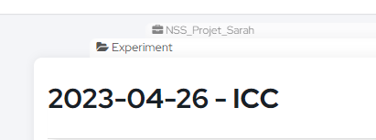
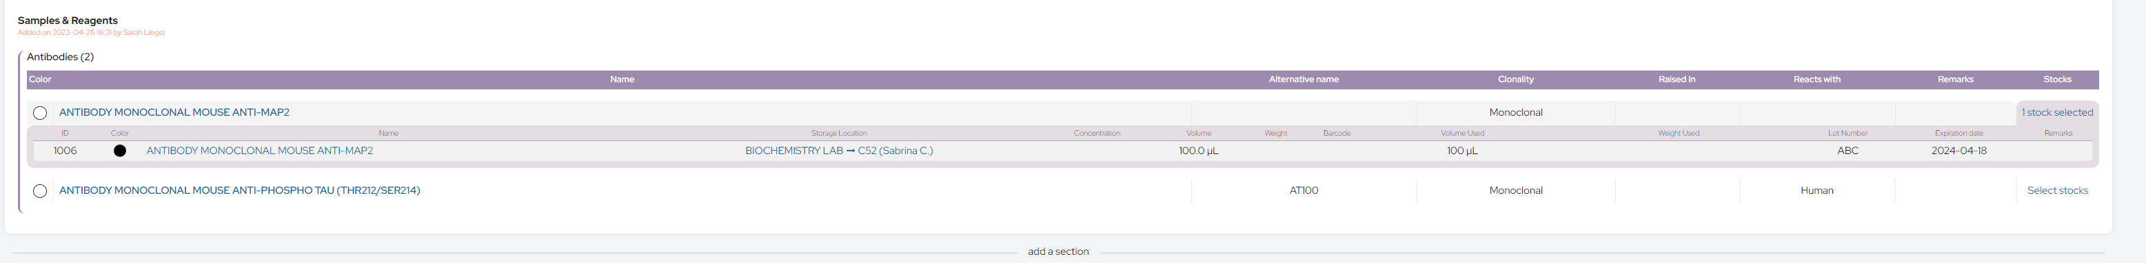
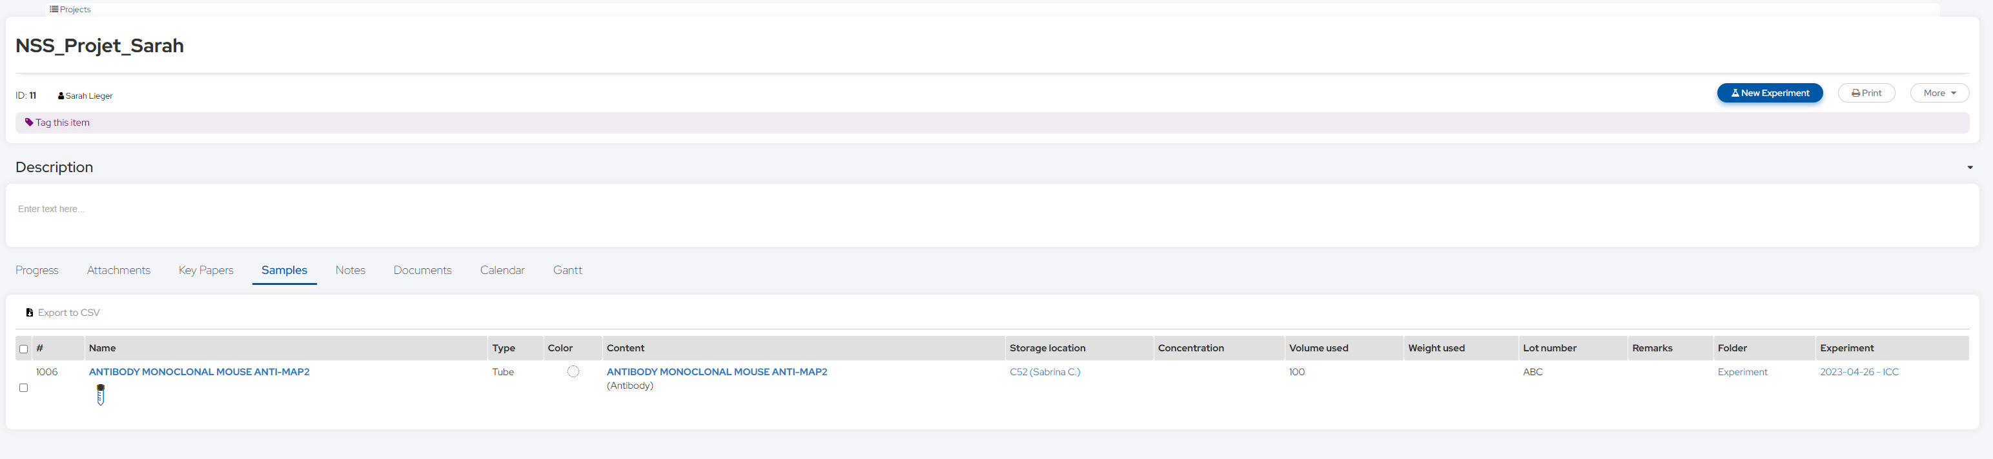
NSS_Projet_Sarah > Experiment : 2023-04-26 - ICC
1 experiment for 2 projects
Remaining quantity : 100 µL
Using 100 µL of MAP2 Antibody for both projects
NSS_Projet_Sarah > Samples
Experiment finished ➔ duplicate then move in the second project.

Slide 3
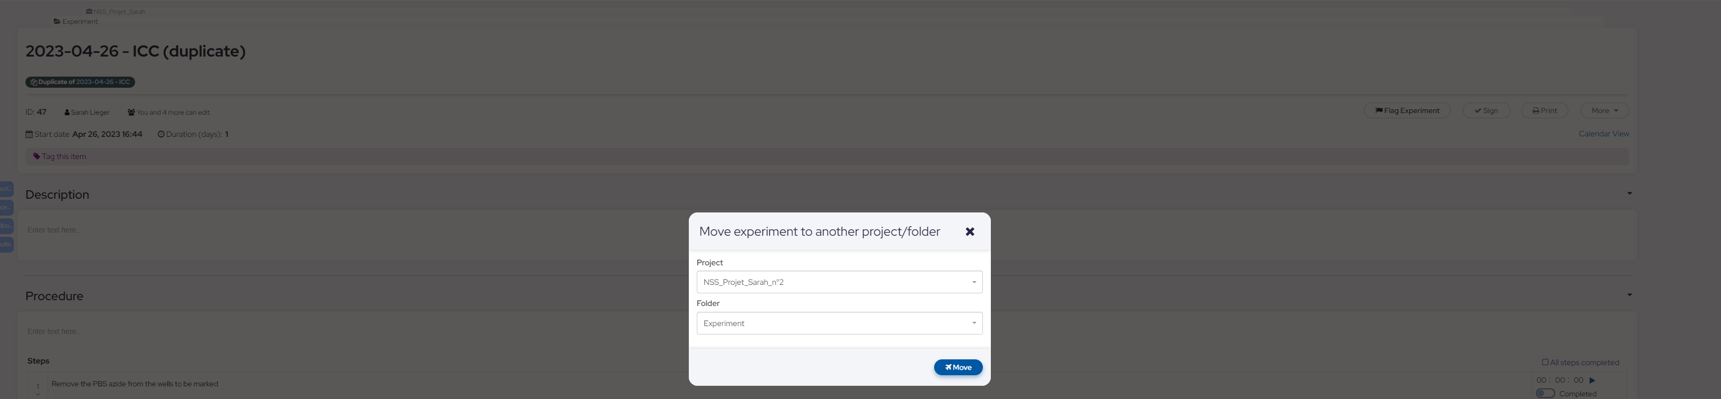
ICC duplicate moved in NSS_Projet_Sarah_n°2

Slide 4
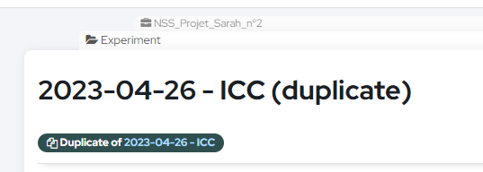
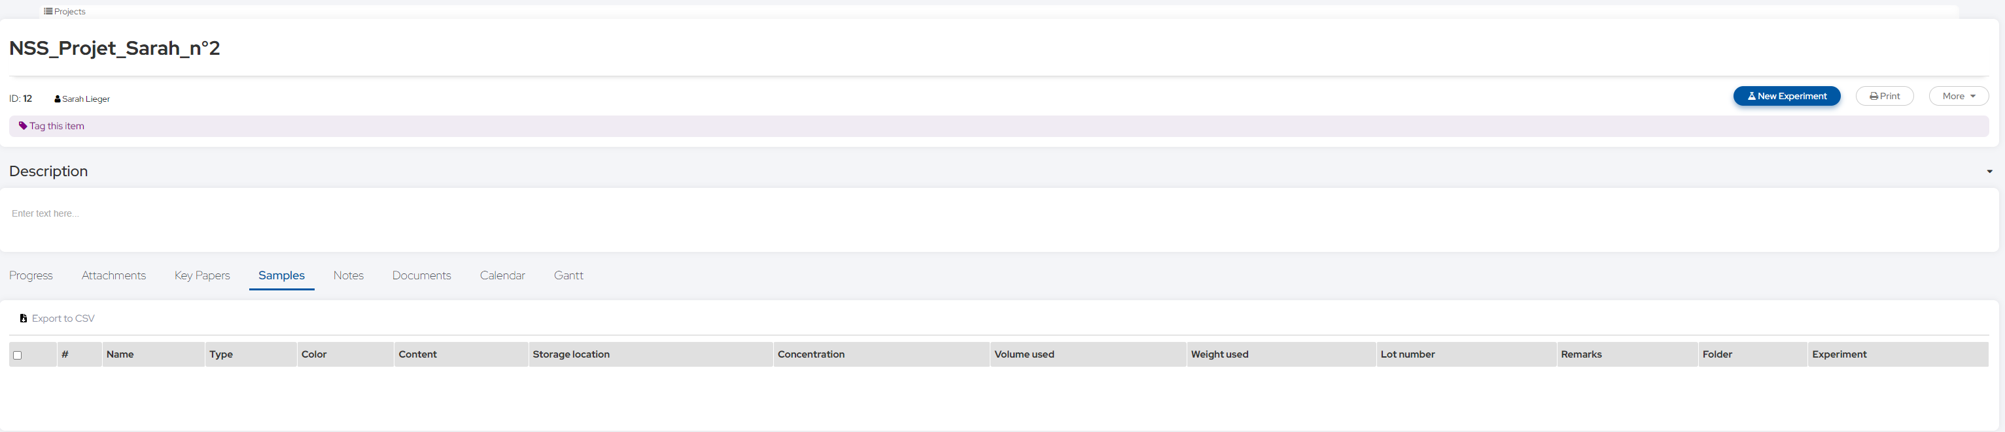
NSS_Projet_Sarah_n°2 > Experiment : 2023-04-26 – ICC (duplicate)
Stocks have disappeared !
NSS_Projet_Sarah_n°2 > Samples
No samples !

